Slide 1
What is Satire?

Slide 2
A general description:
https://prezi.com/enz_f-jnzyqk/satire-lesson/

Slide 3
Examples:
Totino’s Pizza Rolls
https://www.youtube.com/watch?v=A8WIBv3erj8&t=64s
Star Wars Toys
https://www.youtube.com/watch?v=EYyuo7gm-aQ
President Barbie
https://www.youtube.com/watch?v=1Se8PVZdfPg&app=desktop

Slide 4
How to create satire:
1. Identify a target.
  What is something in our culture/society that is ridiculous and needs change?
2. Identify aspects of that target worthy of ridicule.
3. Use the satirical techniques (exaggeration, understatement, incongruity, absurdity, irony and parody) to call attention to those aspects.
  Be appropriate, but look for something to point out in a silly way. Take the hateful passion out of the topic and replace it with silly.

Slide 5
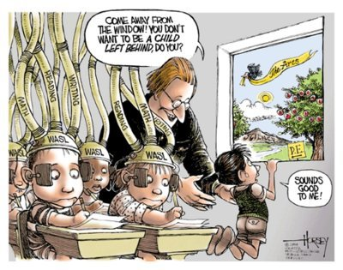
Look at this cartoon:

Slide 6

In light of the college acceptance scandal.

Slide 7
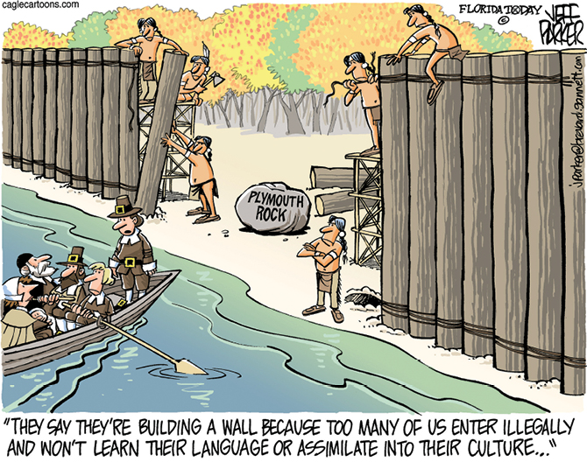

Slide 8
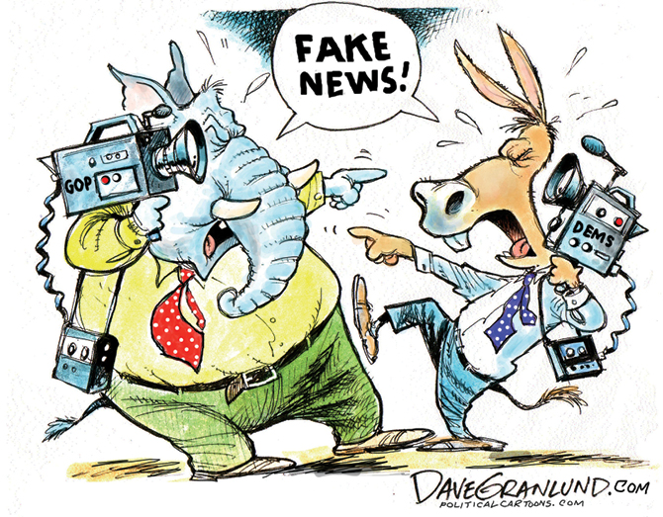

Slide 9
